Slide 1
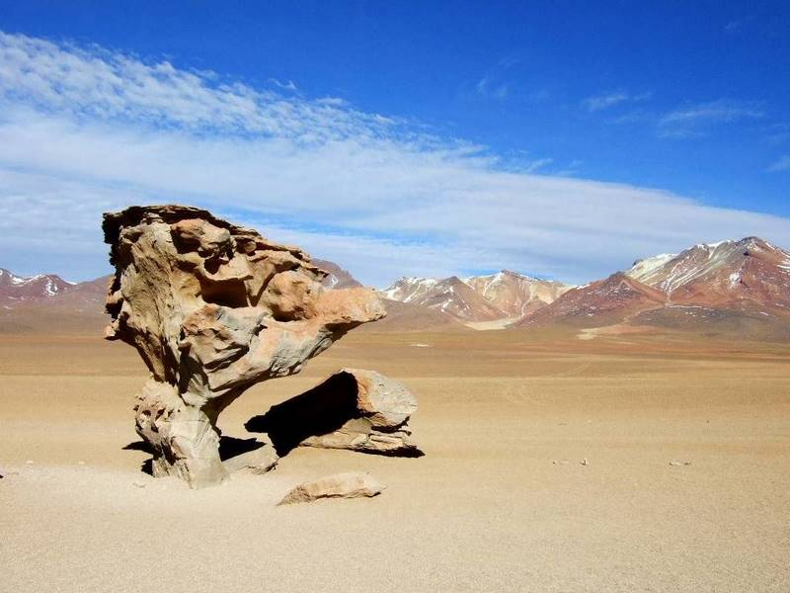

Árbol de Piedra - Bolivia

Slide 2
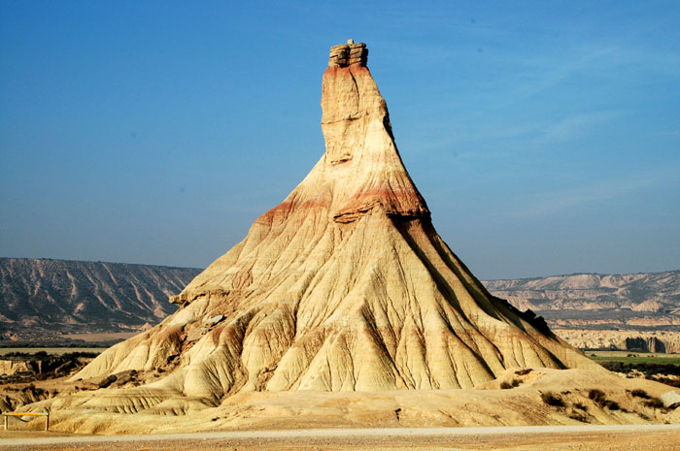
Bárdenas Reales - Navarra - Spain

Slide 3
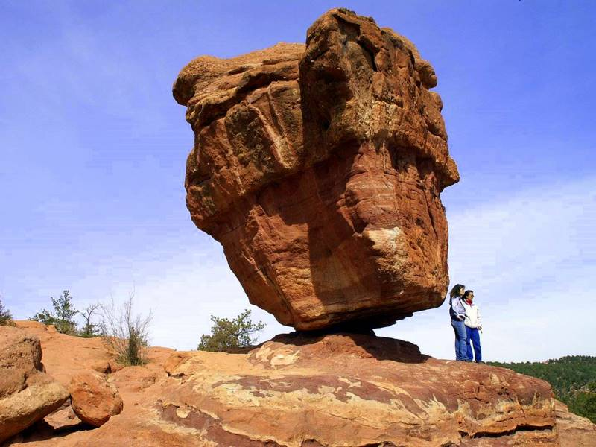
Balanced Rock, Garden of the Gods
Colorado, USA

Slide 4
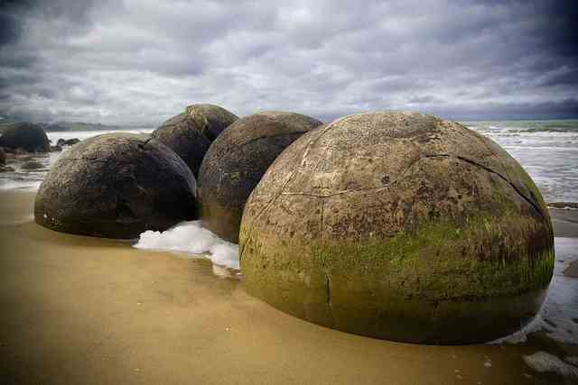
Boulders - South Island - New Zealand

Slide 5
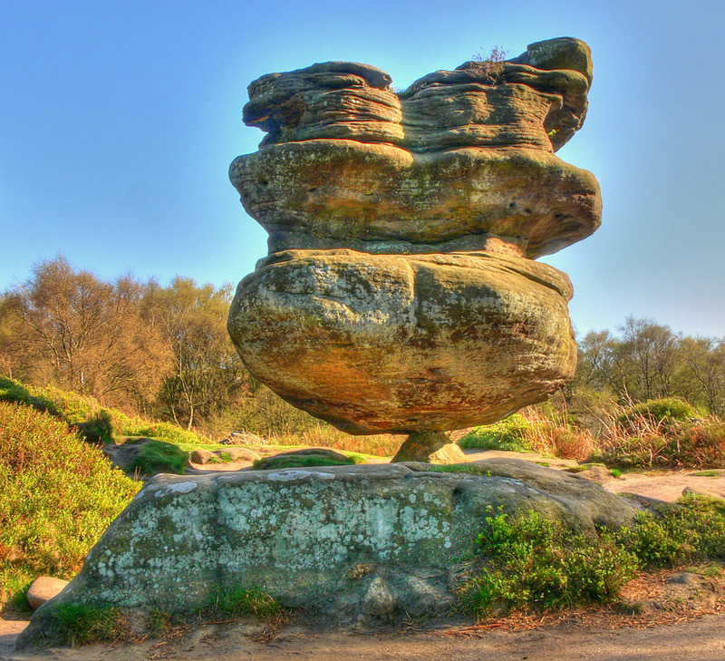
Brimham Rock - England, UK

Slide 6
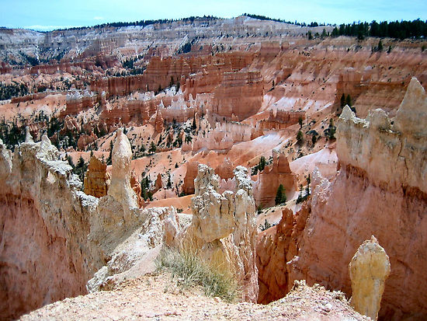
Bryce Canyon National Park - Utah, USA

Slide 7
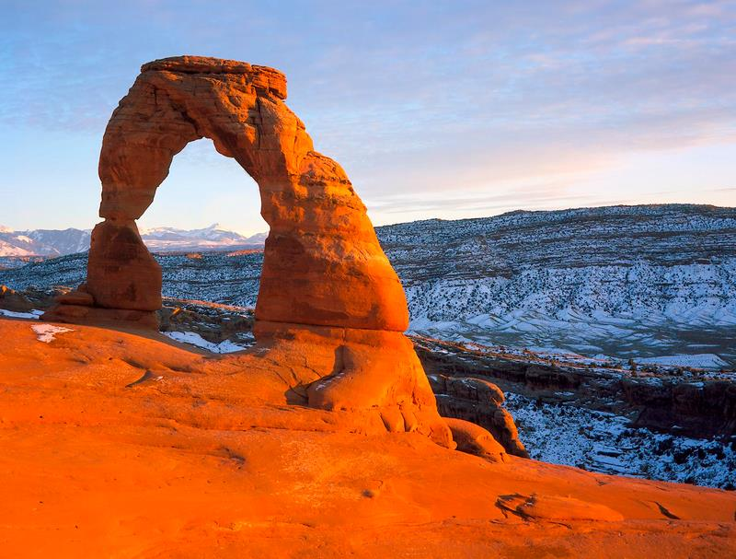
Delicate Arch - Utah, USA

Slide 8
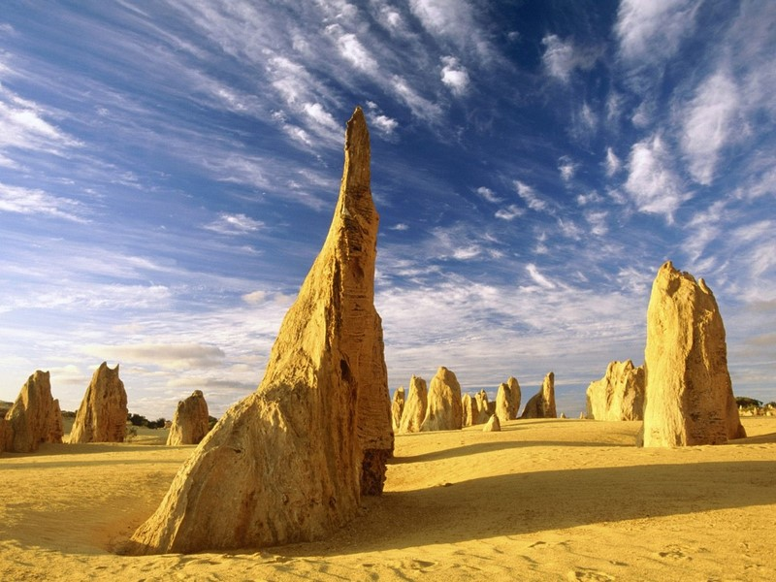
Pinnacles desert - Nambung National Park - Western Australia

Slide 9
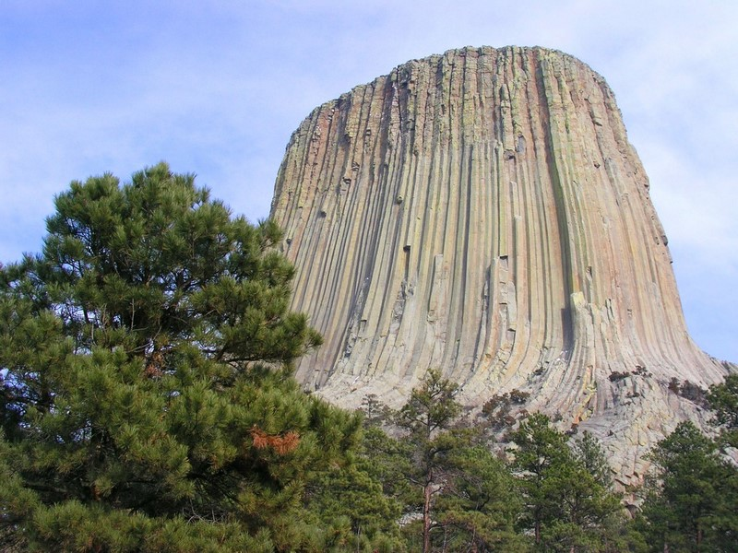
Devils Tower - Wyoming, USA

Slide 10
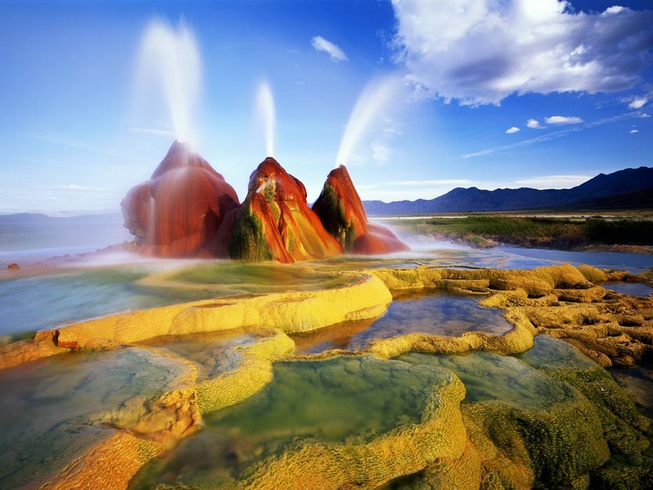
Geiser Black Rock Desert - Nevada, USA

Slide 11
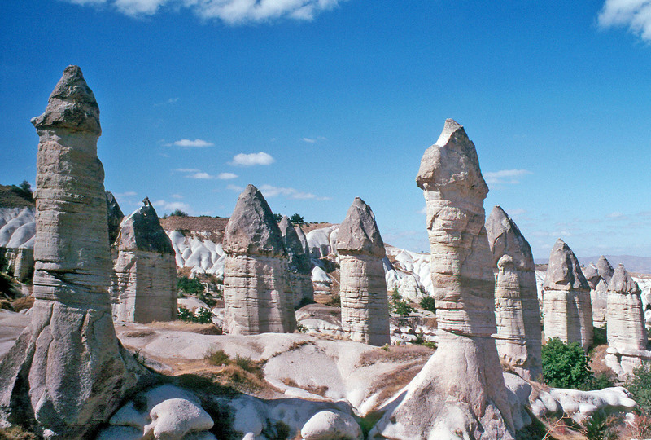
Goreme Valley Fairy Chimneys - Turkey

Slide 12
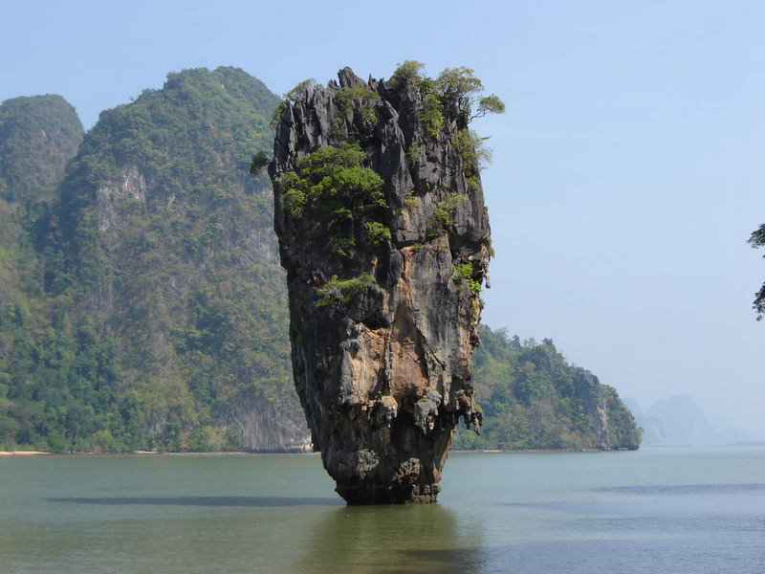
James Bond Island - Thailand

Slide 13
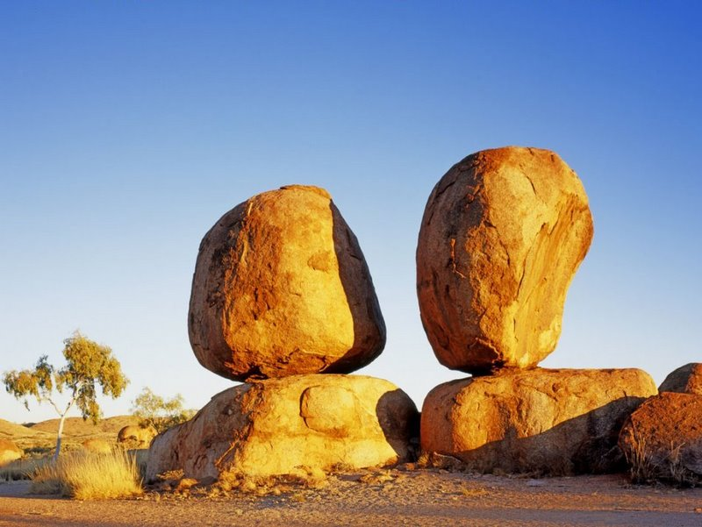
Karlu Karlu or Devil's Marbles - Northern Territory - Australia

Slide 14
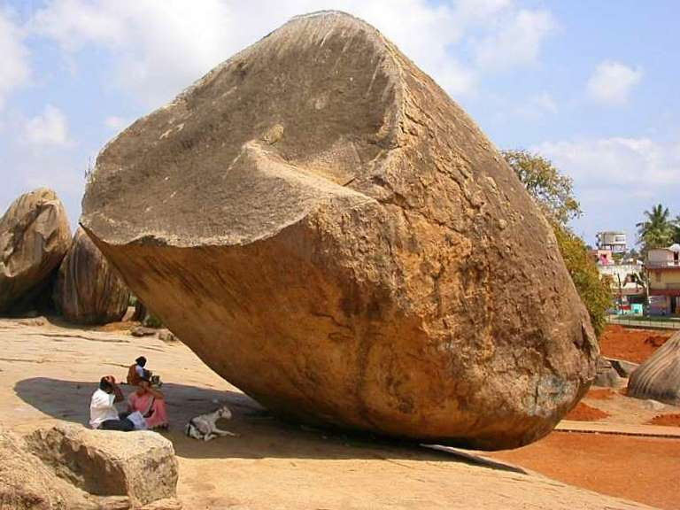
Krishna's Butterball - India

Slide 15
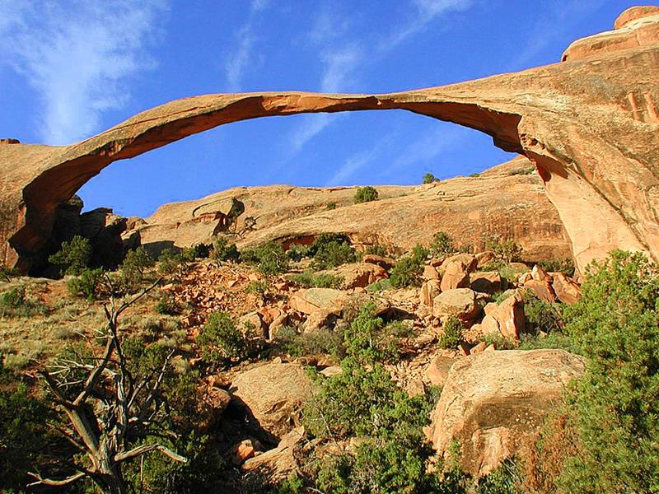
Landscape Arch - Utah, USA

Slide 16
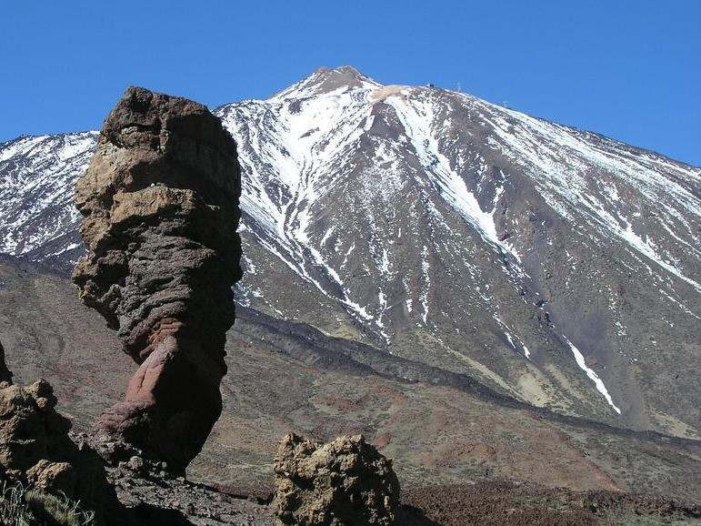
Los Roques - Tenerife

Slide 17
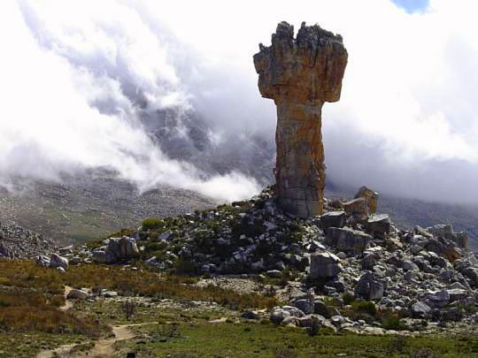
Maltese Cross Rock - South Africa

Slide 18
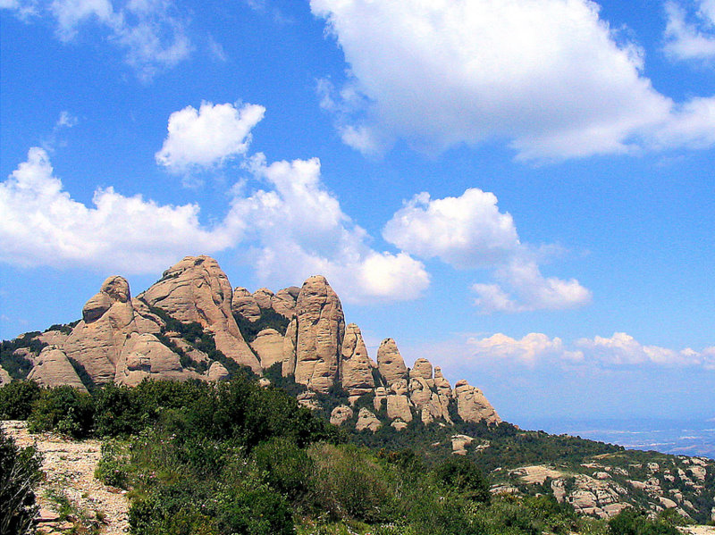
Montserrat - Catalonia

Slide 19
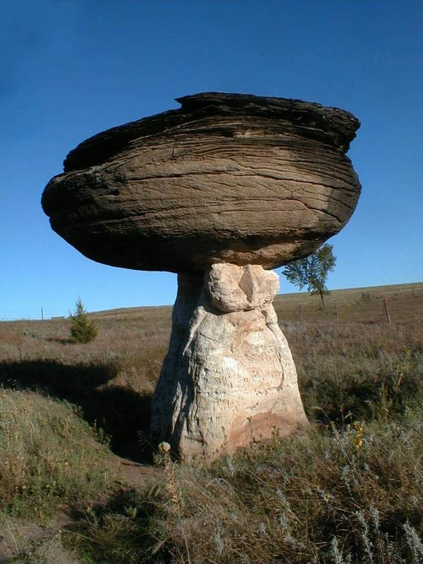
Mushroom Rock - Kansas, USA

Slide 20
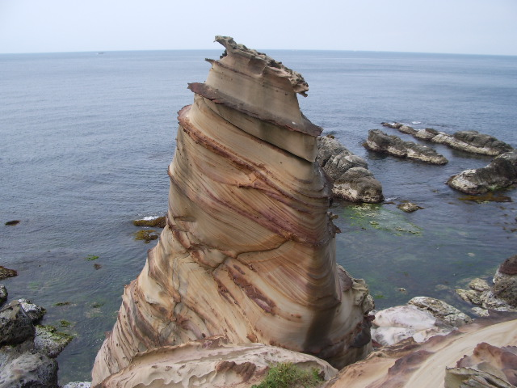
Nanya Rock - Taiwan, China

Slide 21
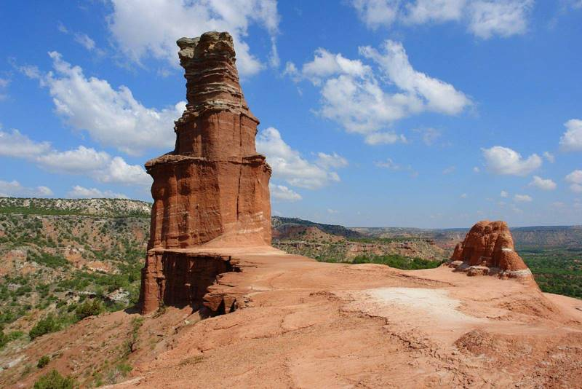
Palo Duro Canyon - Texas, USA

Slide 22
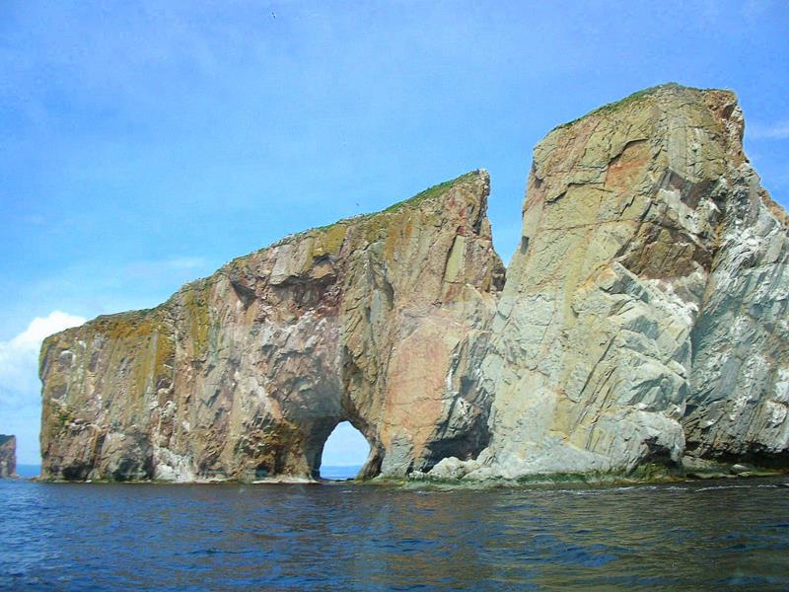
Perce Rock - Canada

Slide 23
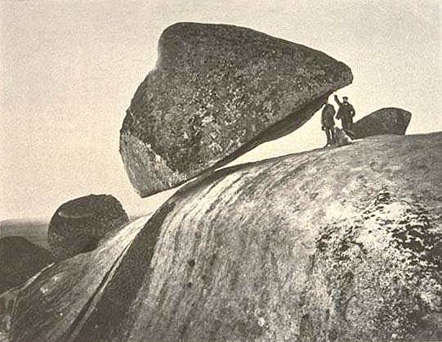
Piedra movediza del Tandil - Argentina

Slide 24
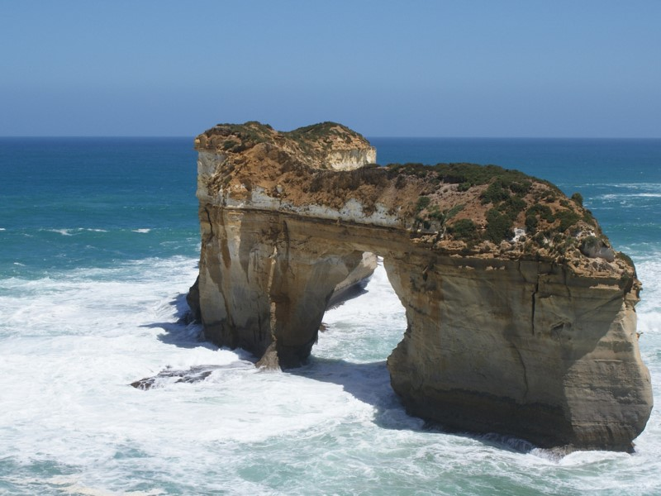
Port Campbell - Australia

Slide 25
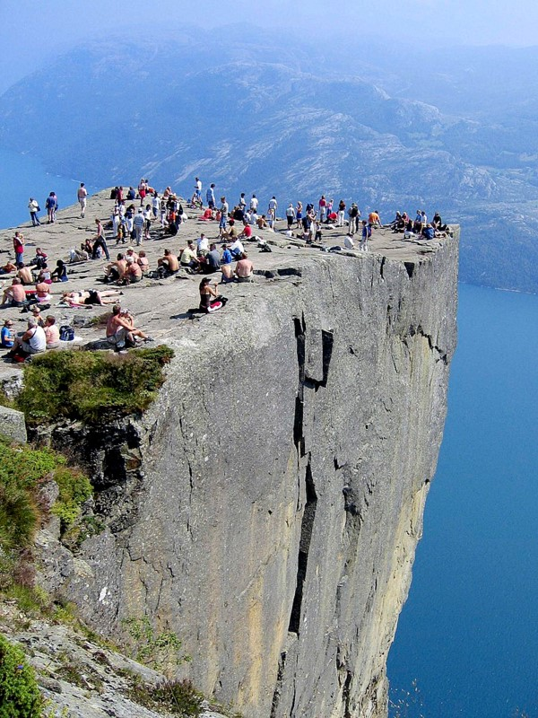
Prekestolen - Norway

Slide 26
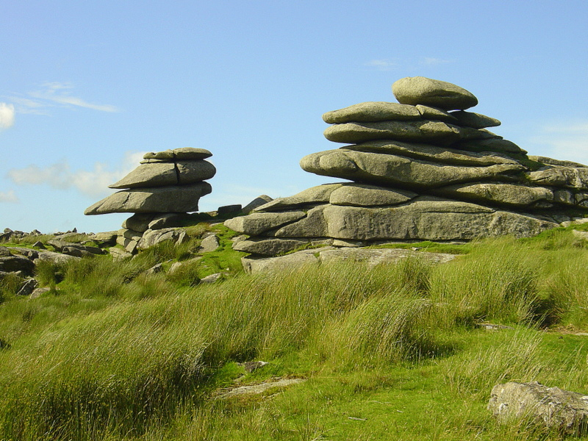
The Cheesewring - UK

Slide 27
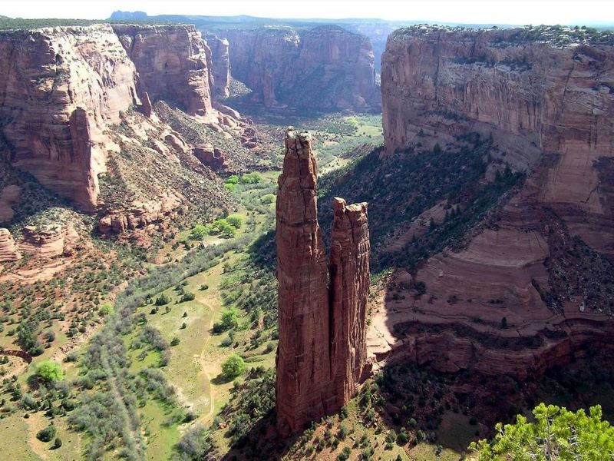
Spider Rock, Chelly Canyon - Arizona, USA

Slide 28
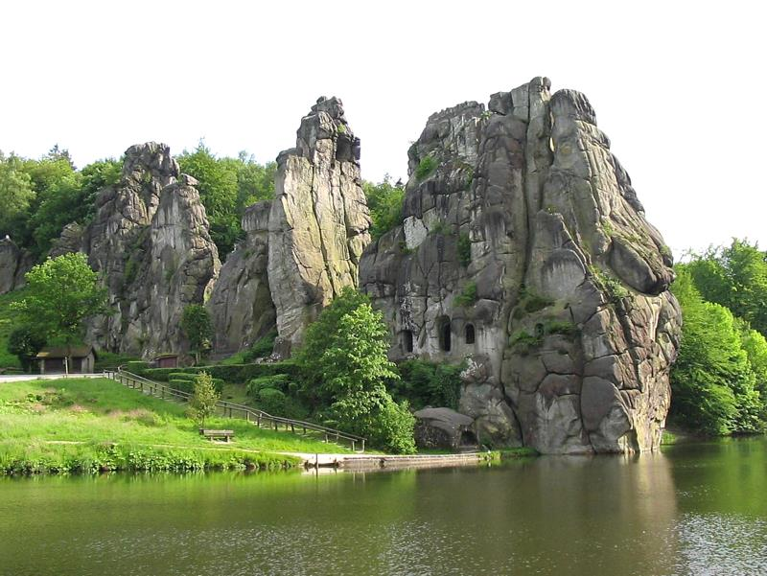
The Externsteine - Germany

Slide 29
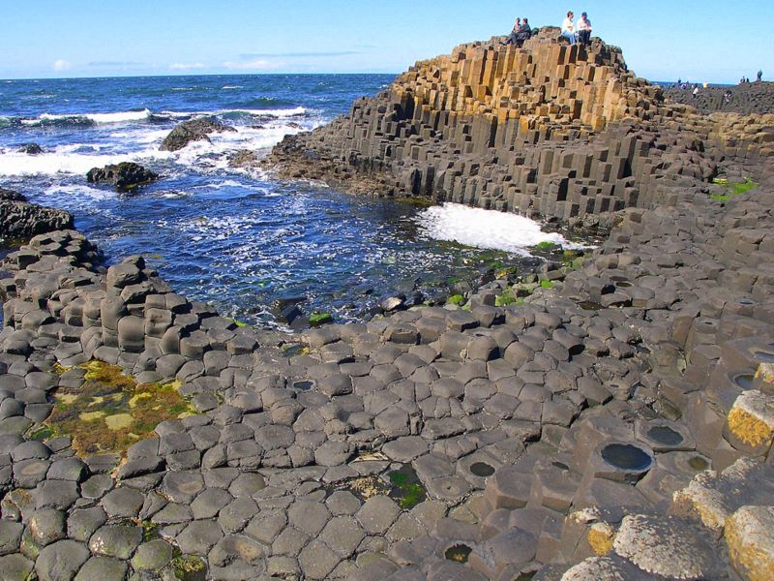
The Giant's Causeway - Northern Ireland, UK

Slide 30
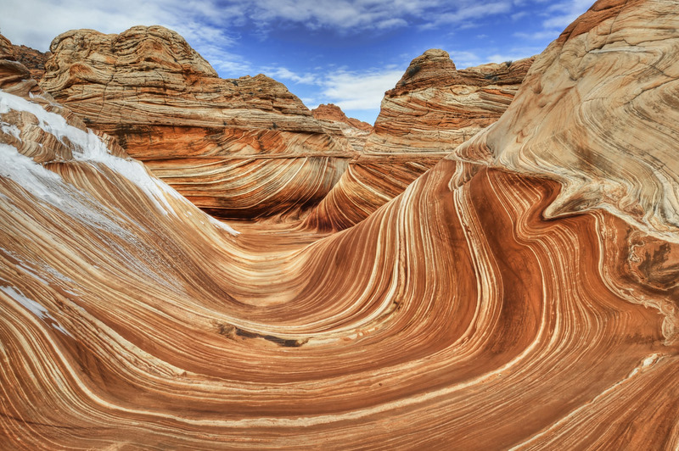
The Wave - Arizona, USA

Slide 31
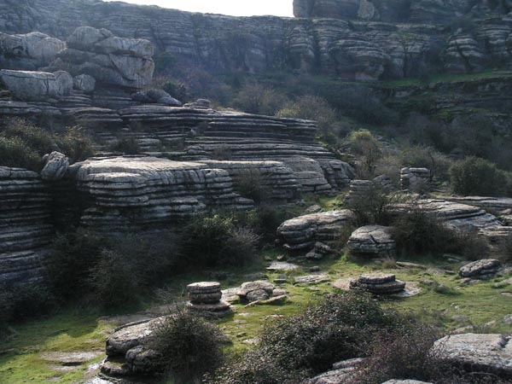
Torcal de Antequera - Andalusia

Slide 32
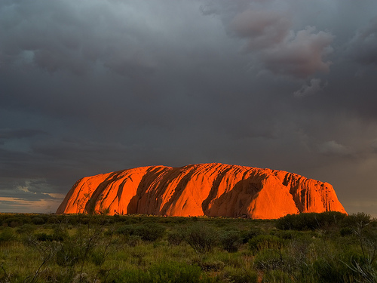
Uluru, Ayers Rock - Australia

Slide 33
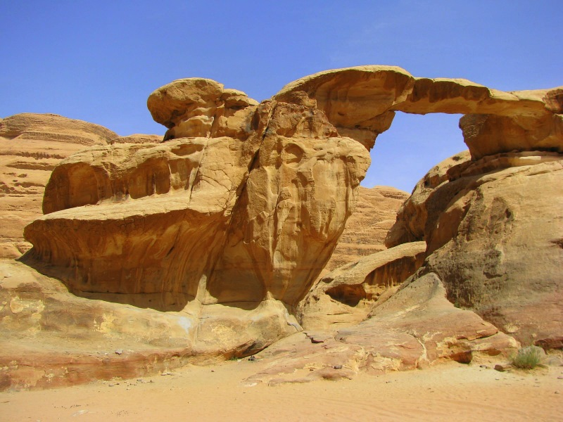
Wadi Rum - Jordania

Slide 34
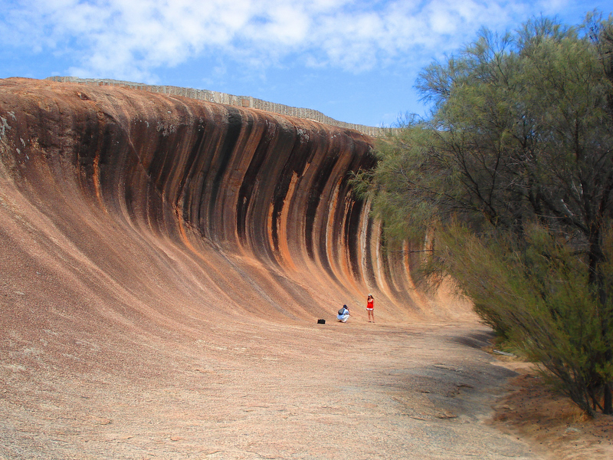
Wave Rock - Western Australia

